Slide 1
1. Teacher Instructions
Title: Waterway investigation: Turbidity and erosion
Length: Approximately 120 minutes
Description: This lesson plan explores the link between turbidity (a measure of water clarity) and erosion. It highlights the effect of high levels of turbidity on the survival of living things in freshwater environments and the link between turbidity and erosion.
Overview:
learn about turbidity and erosion
understand the impacts of turbidity and erosion
participate in an erosion action game
Equipment:
Three water samples in large jars e.g. tap water, a relatively clear creek water sample and a turbid creek/river water sample.
A second jar of tap water
Containers of sand, silt, clay, soil, milk, tea and/or soy sauce
Images of creek or river-banks showing varying degrees of erosion damage or you can use the images on slide 1.5 Streambank erosion
Three buckets of water samples of varying turbidity (i.e. tap water, clear creek water, turbid water)
Preparation: Organise to collect the water samples from different sites.
***See Notes on each slide for more teaching notes and ideas***

Slide 2
Instructions
The following is a suggested sequence of activities and time allocation. You might want to spend more or less time on specific sections depending on your class and their learning requirements. All resources can be edited to suit your teaching needs.
Slide | Description | Time
Background information for teachers | Key messages and information about turbidity: a definition, how it is measured, sources of turbidity and natural variation | n/a
1.1: Introduction | Discuss our connections to waterways | 10 minutes
1.2: Turbidity | Explore the factors that affect turbidity in waterways. | 10 minutes
1.3 Turbidity explained | Show the two freshwater creek samples and the sample of tap water | 15 minutes
1.4: Linking turbidity and erosion | Show different samples in jars (sand, soil, milk, tea etc.) and make observations | 20 minutes
1.5: Streambank erosion | Investigate how streambank erosion affects the turbidity of a waterway | 20 minutes
1.6: Erosion in action game | Play the game to learn about erosion | 30 minutes
1.7: Preventing erosion | Discuss ideas to prevent erosion and reduce turbidity | 15 minutes

Slide 3
Teacher background information
Key messages
Rivers and creeks are the backdrop to lots of recreational activities (walking the dog, riding a bike) and an important part of Melbourne’s liveability.
Our waterways support a diverse range of plant and animal life, including native fish, frogs and platypuses. They are worth looking after.
Reducing the amount of stormwater that can runoff in our city can improve waterway health.
Installing rainwater tanks or wetlands can help slow and reduce stormwater.
The following information is extracted from: Waterwatch Victoria http://www.vic.waterwatch.org.au/monitoring-and-data/1011/ used with permission.
Turbidity
Turbidity is a measure of the clarity of water. As suspended particulate matter including clay, silt, detritus and plankton in the water increases, the clarity decreases and the water takes on a muddy appearance. Turbidity does not measure the quantity of suspended matter in the water. This is measured as suspended particulate matter (SPM), also called suspended solids (SS). While turbidity is not a direct measure SPM, they are highly correlated and turbidity can be used to indicate the likely effects of suspended matter.

Slide 4
Teacher background information
How turbidity is measured
There are several ways turbidity can be measured but all relate to nephelometry, which is a measurement of the size and concentration of particles in water by analysis of light scattered by the water. The greater the scattering of light by suspended particles the greater the turbidity. The measurement unit for turbidity is the nephelomeric turbidity unit (NTU).
Correlations between turbidity and SPM are difficult because differences in size, shape and composition of the suspended particles will affect reflective and absorbance characteristics and hence the scattering of light. Therefore, SPM and turbidity measures within a single site may show a reasonable correlation (as long as the sediment sources are consistent) but this correlation is unlikely to be transferrable to other sites.
Turbidity should be measured as soon as a sample is taken, as suspended matter may stick to the walls of the container or bind together through physical and chemical processes (e.g. temperature).
Turbidity tubes measure the absorbance of light rather than the scattering of light. While they will at times overestimate or underestimate turbidity and do not measure very low levels accurately, they are generally a good estimate of the true turbidity. The Secchi disk has been used extensively in the past to measure water clarity, particularly in deep water environments such as lakes. Secchi disks are not recommended for monitoring turbidity as there are no related water quality guidelines.

Slide 5
Teacher background information
Sources of turbidity
Most of the sediment in rivers and streams comes from catchment and stream bank erosion. Sediment entering waterways is a natural process but human land use can result in excessive quantities entering waterways. Agriculture, forestry and housing developments can all lead to extensive soil disturbance, erosion and sediment runoff to rivers and streams. Unsealed roads can also contribute substantial quantities of sediment to waterways. Carp, an introduced pest fish species, can increase the mobilisation of sediment due to its habit of digging in stream sediments and dislodging macrophytes, resulting in unstable stream beds.
Other sources of sediment include sewage effluent discharges, industrial discharges, septic tank discharges and destabilisation of bed and banks after the removal of snags and macrophytes.
Natural variation
Levels of turbidity in water will vary depending on the physical and chemical activities in the river. Typically, turbidity levels increase from headwaters to lowlands. The old geology and associated high levels of clays result in naturally higher levels of turbidity in our rivers and streams compared to those overseas. Extensive clearing has made Australian soils more prone to erosion, increasing sediment loads and turbidity.
Turbidity levels vary over time. High flows (whether seasonal or episodic) are typically associated with increased inputs of sediment. If storms follow bushfires, even higher sediment loads can be expected.

Slide 6
Turbidity and erosion
A waterway investigation

Slide 7
Learning outcomes
Describe the importance of waterways and how they have shaped Melbourne's environment
Describe how waterway environments - habitats are changed and managed by people
Identify the physical conditions of aquatic habitats

Slide 8
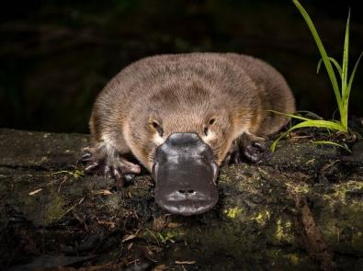
1.1 Introduction
Water may flow directly into a waterway, over land as run-off or through drains as stormwater. This water can collect silt, clay or soil particles and become a significant contributor to waterway pollution.
An increase in turbidity results in:
a decrease in the water clarity
harmful effects on aquatic animals and plants.
Identifying the causes and effects of increased turbidity in our rivers and creeks, helps us understand and appreciate the influences of our own actions on waterway health.
Clarity: how clear the water is
Notes:
Teaching notes & ideas
This lesson guide the link between turbidity (a measure of water clarity) and erosion. It highlights the effect of high levels of turbidity on the survival of living things in freshwater environments and the link between turbidity and erosion.

Slide 9
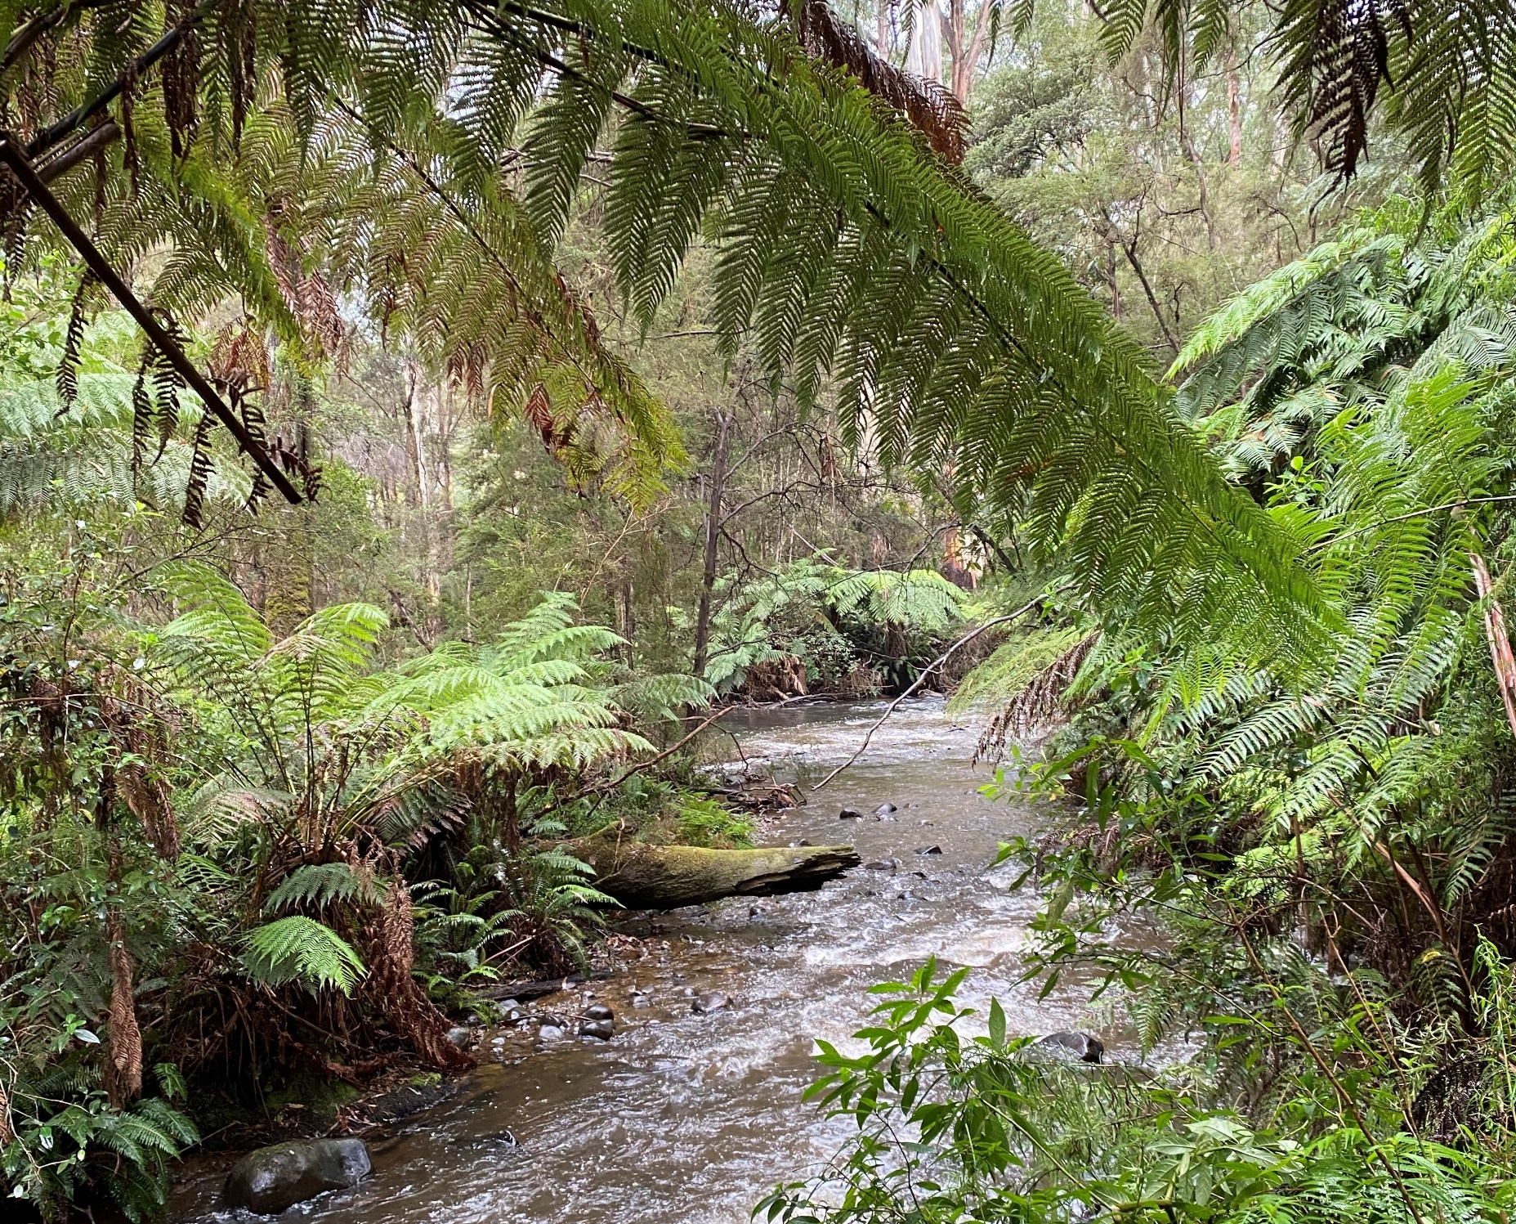
1.2: Turbidity
Why are some rivers and creeks clear and others murky?
What might contribute to waterway clarity?
Notes:
Teaching notes & ideas
In this activity, students explore the factors that affect turbidity in waterways.
Step 1: Encourage students to connect with freshwater environments by asking them to recall activities they do in and around rivers and creeks. Question: What activities do you do in and around rivers and creeks?
Answers: they may swim, walk or ride past, fish etc.
Step 2: Explain that rivers and creeks can differ in water clarity with some being clear and others murky, stained brown, muddy or cloudy. For example, the Yarra River’s colour is influenced by the type of soil in the catchment.
Step 3: Explain and define stormwater and run-off. Water running overland into waterways is called run-off (or surface run-off), and ‘stormwater’ may be differentiated as water flowing in through drain outlets. You can show students the Water and waterways video <insert link>
Step 4: Explain that we are going to investigate different types of water clarity today and also how it is measured

Slide 10
1.3: Turbidity explained
Sample 1: (freshwater creek)
Sample 2: (freshwater creek)
Sample 3: Tap water
Describe each sample.
Is all clear water safe to drink? Why/ Why not?
Notes:
Teaching notes & ideas
Step 1: Collect water samples from two different creeks and a sample from the tap. Add the name of each creek to the slide. If you can only collect a sample from one creek, the activity can still be completed. Update the slide as required.
Question: Describe each sample.
Answer: Descriptions may include:
turbid creek water: muddy, cloudy, dirty, brown, murky and unhealthy
clearer creek water: quite clear, quite healthy
tap water: clear, see-through, healthy.
Note: If students say that tap water, which will always be clearest, is the healthiest discuss this and make the point that some particulate matter is important for the food web.
Question: Is all clear water safe to drink? Why/ Why not? Explain your reasoning.
Answer: No, all clear water is not safe to drink. Ensure that students understand that even if creek water looks clear and safe that it could still contain lots of microscopic disease-forming microscopic bacteria. Don’t drink it. Tap water is very safe to drink.
Step 2: Explain that the scientific term for cloudy water is ‘turbid’ i.e. muddy water has a high turbidity and clear water has a low turbidity.
Step 3: Define units of measurement nephelometric turbidity units (NTUs). The term was named after the Greek word for cloud (Nephel) so ‘nephelometric’ means measuring cloudiness.

Slide 11
1.4: Linking turbidity and erosion
Observe differences in suspended particles:
Sample 1: Sand
Sample 2: Silt
Sample 3: Clay
Sample 4: Soil
Sample 5: Milk
Sample 6: Tea
Notes:
Teaching notes & ideas
In this activity students investigate how streambank erosion affects the turbidity of a waterway.
Step 1: Create samples of different mixtures and put in jars (sand, silt, clay, soil, milk, tea etc.)
Note: you can use any mixtures that are easily available. Update the slide as required.
Step 2: Show each of the different samples in jars and ask students to observe the differences in suspended particles.
Step 3:
Question: What makes the water turbid?
Answer: Particles of clay, silt, mud, sand and soil
Step 4: Explain that some of these particles are suspended in the water and affect its clarity.
Step 4: Question: How could soil get into the water?
Answer: Discuss the process of erosion with students.

Slide 12
1.5: Streambank erosion
How much erosion can you see?
How do plants (vegetation) help to prevent erosion?
Notes:
Teaching notes & ideas
Step 1: Show the pictures of different creek or riverbanks. You can use these images or replace with images from a local waterway showing erosion.
Question: How much erosion can you see?
Answer: Most erosion can be seen in the middle image, with some erosion in the picture on the left.
Question: How do plants (vegetation) help to prevent erosion?
Answer: Plant roots help bind the soil together and slow down runoff which reduces erosion.
Optional: Fieldtrip
If you have the opportunity, take the students to a local creek. In pairs, they could investigate the hypothesis that vegetation on the creek banks reduces the amount of erosion. Students could explore the banks and record their ideas with photographs, drawings or field notes. The root systems of grasses, trees, shrubs and water plants will hopefully be present. They may find an area with no plants and see an ‘erosion scar’. Have students define the waterway you are visiting as clear or turbid.

Slide 13
Erosion in action game
Group 1 are shrubs: kneel-down in a line and can only move their arms (leaves).
Group 2 are trees: line up behind the shrubs and can only move their arms (branches).
Group 3 are dirt: must try to enter the river (behind the trees) and get past the vegetation without being stopped (touched by the shrubs/trees).
Notes:
Teaching notes & ideas
Students identify ways in which we can minimise the impacts of erosion on the quality of water in the creeks around Melbourne.
Step 1: Divide the class into three groups
Note: No-one (or not many) will get through the first time, so next round cut down some trees and pull out some shrubs (these can now become dirt).
Step 2: Replay game with fewer plants, then start to re-vegetate and see what difference the plants make to dirt entering the river.
Step 3: Ask students to
Reflect on how vegetation affected how much dirt could enter the waterway?
What might have been the effect on the waterway each time something changed?
What effect might there have been on the living things in the waterway?

Slide 14
1.7: Preventing erosion and turbidity
What actions can help prevent erosion and improve waterway health?
How might turbidity change over time?
What can the effect of pollution be in a creek?
How might forestry impact on erosion and turbidity?
How could we reduce the amount of stormwater at school?
Notes:
Teaching notes & ideas
Students identify ways in which we can minimise the impacts of erosion on the quality of water in the creeks around Melbourne.
Question: What actions they could take to help prevent erosion and improve waterway health?
Answer/s:
participate in local creek or river revegetation program, for example, through a community Landcare project.
stay on paths when walking along rivers, avoiding trampling vegetation.
make sure litter goes into the bin and not into stormwater.
cover stormwater drains with scrunched-up sheets of paper to stop dirt when doing garden, building and driveway works at home that need lots of digging and dirt piling.
Questions: Further questions could include:
How might turbidity change over time?
What can the effect of pollution be in a creek?
How might forestry impact on erosion and turbidity?
How could we reduce the amount of stormwater at school?
Note: The impact of turbidity
Suspended particles reduce the amount of light that passes through water. This can reduce the growth of submerged aquatic plants (underwater plants) by limiting photosynthesis. A lack of light can also make it difficult to see, so predators that feed in the water like fish and birds cannot hunt as successfully. Also particles absorb heat so the water temperature rises faster than it would in clear water. Warmer water can affect plant growth, the behaviour or animals and at extreme levels, animals may die. Sediment particles will eventually settle on the riverbed, on and in between the gravel and rocks. This decreases the amount and type of habitat available for creatures that live and lay eggs on and in those crevices. Sediments can clog fish gills, inducing disease, slower growth and, in extreme cases restrict oxygen and cause death. Other pollutants may also stick to the sediment particles. (If a whiteboard is available, you can draw a diagram to explain these effects. The fact that sediments enter a waterway is a natural process but there are factors that can affect how much enters the water. In Australia, compared with overseas countries, we have old soils that are more likely to erode into our waterways.

Slide 15
Curriculum links
Science: VC2S6U01, VC2S6U05
Geography: VC2HG6K01, VC2HG6K03, VC2HG6K04

